Slide 1
Angular 4
Dragoiu Raul
Florea Andrei

Slide 2
Angular 4
What is Angular 4?
Angular 1 vs Angular 2 vs Angular 4
Setup and First App
Data binding
ReactiveX
Observables
HTTP Protocol
Communication with a REST Server
Upload Picture

Slide 3
Angular 4
What is Angular 4?

Slide 4
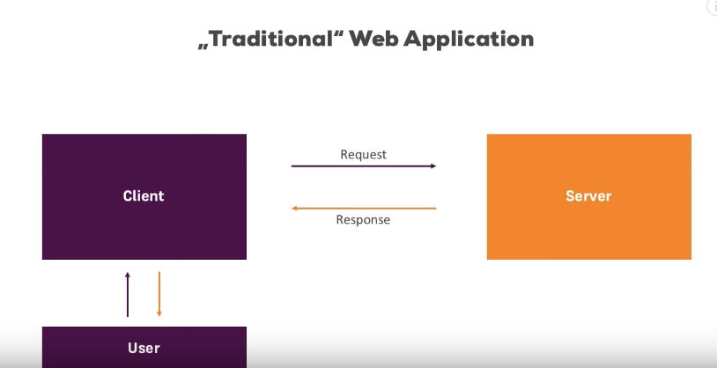
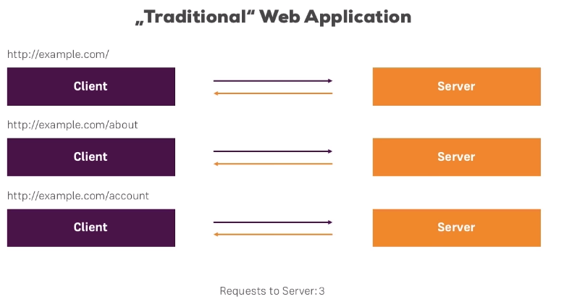
Angular 4
Angular 4 is a JavaScript Framework which allows you to create reactive Single-Page-Applications(SPAs).

Slide 5
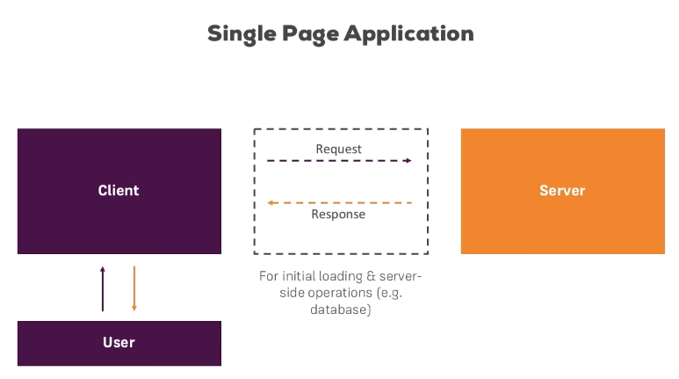
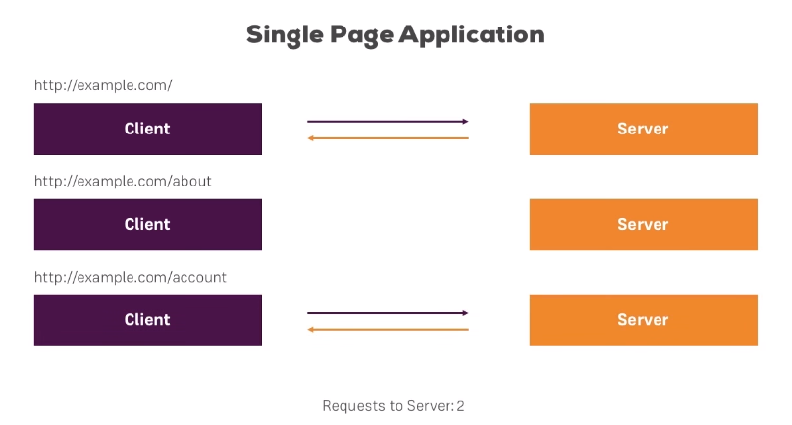

Slide 6
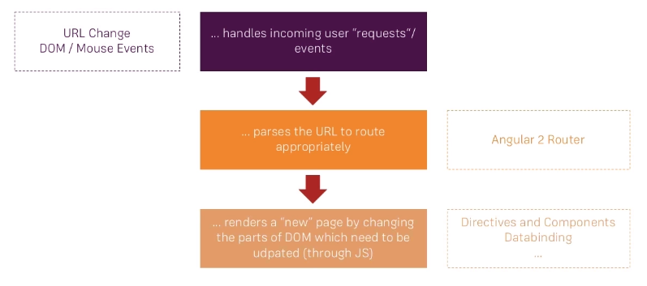
SAPs in Angular 4

Slide 7
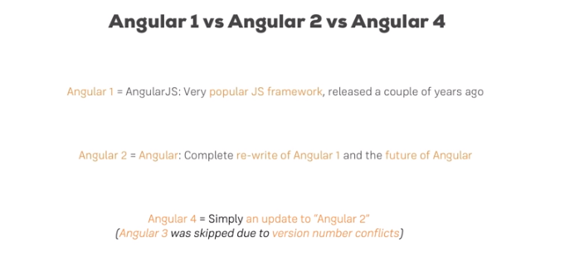

Slide 8
Setup&First app

Slide 9
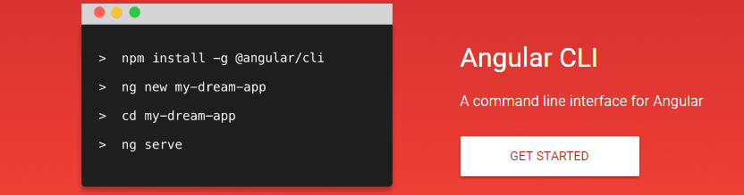
Angular CLI
For this you can use Angular CLI which is a command line interface to scaffold and build angular apps using nodejs style (commonJs) modules. Not only it provides you scalable project structure, instead it handles all common tedious tasks for you out of the box. The CLI is a great tool for big and very big Angular projects.(before this you need too download and install nodeJs)

Slide 10
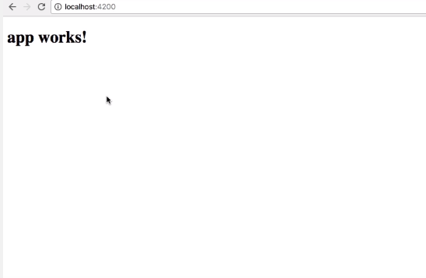
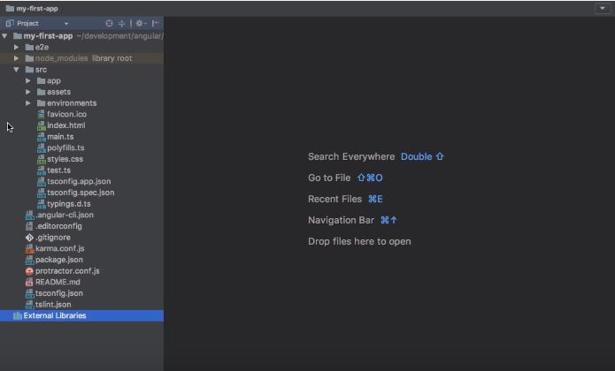
After that commands are runned you should have a simple aplication that already works and if you access the http://localhost:4200 you can see the result.

Slide 11
Databinding

Slide 12
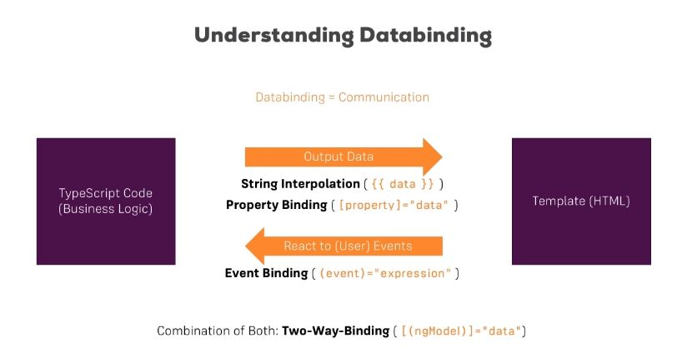
What is databinding?

Slide 13
String Interpolation {{}}
You met the double-curly braces of interpolation, {{ and }}. You use interpolation to weave calculated strings into the text between HTML element tags and within attribute assignments.The text between the braces is often the name of a component property. Angular replaces that name with the string value of the corresponding component property. More generally, the text between the braces is a template expression that Angular first evaluates and then converts to a string. The expression can invoke methods of the host component.
<div> <span style="font-weight: bold">Owner:</span> {{selectedResource.fullNameUser}} </div>
<p>The sum of 1 + 1 is {{1 + 1 + getVal()}}</p> where int getVal(){ return 2;} <!-- "The sum of 1 + 1 is 4" -->

Slide 14
Property binding ( [property] )
Write a template property binding to set a property of a view element. The binding sets the property to the value of a template expression. The most common property binding sets an element property to a component property value.
<img [src]="imageUrl">
Another example is disabling a button when the component says that it isUnchanged:
<button [disabled]="isUnchanged">Cancel is disabled</button>

Slide 15
Event binding ( (event) )
The only way to know about a user action is to listen for certain events such as keystrokes, mouse movements, clicks, and touches. You declare your interest in user actions through Angular event binding. Event binding syntax consists of a target event name within parentheses on the left of an equal sign, and a quoted template statement on the right. The following event binding listens for the button's click events, calling the component's onSave() method whenever a click occurs:<button (click)="onSave()">Save</button>
Some people prefer the on- prefix alternative, known as the canonical form:
<button on-click="onSave()">On Save</button>

Slide 16
Angular 4
ReactiveX

Slide 17
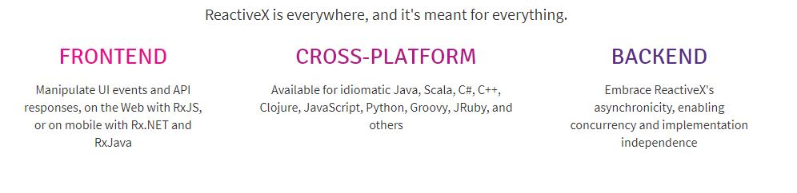
ReactiveX
ReactiveX is a library for composing asynchronous and event-based programs by using observable sequences.
Reactive programming is programming with asynchronous data streams.
Angular 2 embraces elements of reactive programming, a paradigm focused on how data flows through an application. To follow the reactive approach, we use Observables to build services and components that can react to changes in data across our application. Observables aren't exactly an Angular 2 specific feature, they're a part of the JavaScript Reactive Extensions library (RxJS) and are set to be an included feature in the release of ES7.

Slide 18
ReactiveX
Non programming example of Synchronous vs Asynchronous:
Synchronous : You want a pizza for dinner and you are out of the frozen kind. So you have to stop playing WOW which upsets your clan. You go to the kitchen, make the dough, cover it with sauce, add the cheese, and smother it your favorite bacon topping. You just spent 20 minutes of your time making the pizza with another 10 minutes in the oven. The timer beeps and you pull the hot pie out. You can sit back down in front of your computer, eat the pizza, and continue with your conquest.
Asynchronous : You want a pizza for dinner while playing WOW. You open up a browser window on your 5th monitor. You load up the Pizza website and order your extra cheesy bacon pizza with a side of bacon grease garlic sauce. You go back to your raid and after 20 minutes the door bell rings. You get the pizza. You sit back down in front of your computer, eat the pizza, and continue with your conquest.

Slide 19
Angular 4
Observables

Slide 20
Observables
In ReactiveX an observer subscribes to an Observable. Then that observer reacts to whatever item or sequence of items the Observable emits.
Observables are elements that will give us information. In order to get access to those information, we need to subscribe to them (a bit like Netflix, but free and without the movies …).
What is great with observables is that they are lazy, they can be canceled and you can apply some operators in them (like map, ...). This allows to handle asynchronous things in a very flexible way.
In many software programming tasks, you more or less expect that the instructions you write will execute and complete incrementally, one-at-a-time, in order as you have written them. But in ReactiveX, many instructions may execute in parallel and their results are later captured, in arbitrary order, by “observers.” Rather than calling a method, you define a mechanism for retrieving and transforming the data, in the form of an “Observable,” and then subscribe an observer to it, at which point the previously-defined mechanism fires into action with the observer standing sentry to capture and respond to its emissions whenever they are ready.

Slide 21
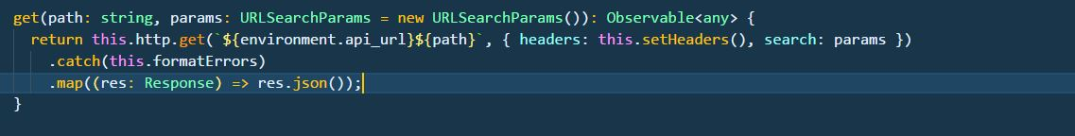
Observables
Usually, you take the results from the success callback and assign it to your variable.
The error callback is self explanatory.
The complete callback is used to determine that you have received the last results without any errors.
.map() is a transformer that will transform the result to whatever you return (in your case .json()) before it's passed to the success callback you should called it once on either one of them.

Slide 22
Observables
.subscribe is the function that actually executes the observable. It takes three callback parameters as follow: .subscribe(success, failure, complete);
.subscribe(
function(response) { console.log("Success Response" + response)},
function(error) { console.log("Error happened" + error)},
function() { console.log("the subscription is completed")}
);

Slide 23
Angular 4
HTTP Protocol

Slide 24
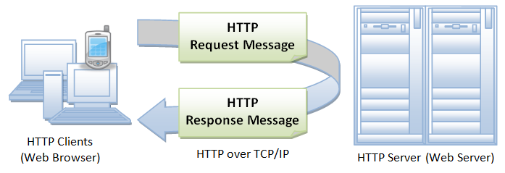
HTTP Protocol
The Hypertext Transfer Protocol (HTTP) is an application-level protocol for distributed, collaborative, hypermedia information systems.
Basically, HTTP is a TCP/IP based communication protocol, that is used to deliver data (HTML files, image files, query results, etc.) on the World Wide Web. The default port is TCP 80, but other ports can be used as well.
It provides a standardized way for computers to communicate with each other. HTTP specification specifies how clients' request data will be constructed and sent to the server, and how the servers respond to these requests.

Slide 25
HTTP Protocol
There are three basic features that make HTTP a simple but powerful protocol:
1) HTTP is connectionless: The HTTP client, i.e., a browser initiates an HTTP request and after a request is made, the client disconnects from the server and waits for a response. The server processes the request and re-establishes the connection with the client to send a response back.
2) HTTP is media independent: It means, any type of data can be sent by HTTP as long as both the client and the server know how to handle the data content. It is required for the client as well as the server to specify the content type using appropriate MIME-type.
3) HTTP is stateless: As mentioned above, HTTP is connectionless and it is a direct result of HTTP being a stateless protocol. The server and client are aware of each other only during a current request. Afterwards, both of them forget about each other. Due to this nature of the protocol, neither the client nor the browser can retain information between different requests across the web pages.

Slide 26
HTTP Protocol
HTTP is based on the client-server architecture model and a stateless request/response protocol that operates by exchanging messages across a reliable TCP/IP connection.
An HTTP "client" is a program (Web browser or any other client) that establishes a connection to a server for the purpose of sending one or more HTTP request messages. An HTTP "server" is a program ( generally a web server like Apache Web Server or Internet Information Services IIS, etc. ) that accepts connections in order to serve HTTP requests by sending HTTP response messages.
GET : The GET method is used to retrieve information from the given server using a given URI. Requests using GET should only retrieve data and should have no other effect on the data.
POST : A POST request is used to send data to the server, for example, customer information, file upload, etc. using HTML forms.
PUT : Replaces all the current representations of the target resource with the uploaded content.
DELETE : Removes all the current representations of the target resource given by URI.

Slide 27
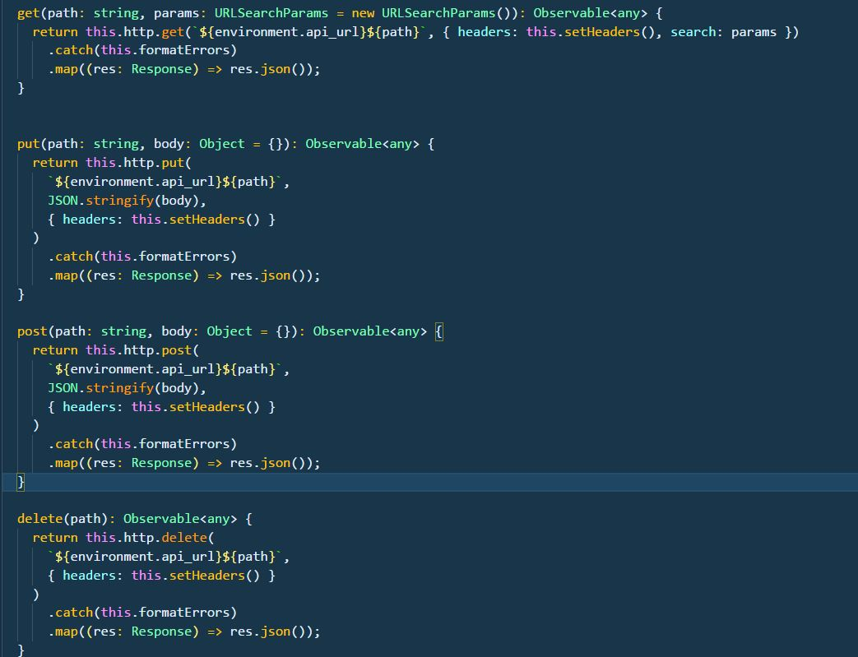

Slide 28
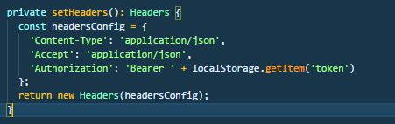
HTTP Protocol
Headers:
Headers is the angular class that is used to configure request headers. Find the sample Headers instantiation.

Slide 29
Angular 4
How does Frontend communicates with the REST Server??

Slide 30
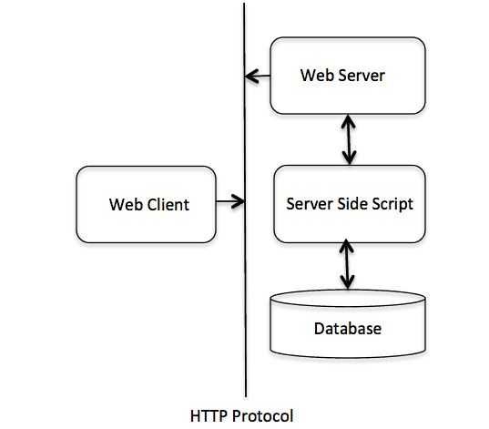
Angular 4

Slide 31
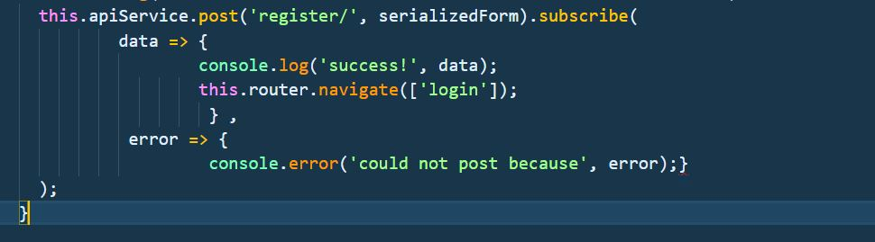

Angular 4
The way the Frontend and Backend communicates is by using the HTTP requests.
We will take as an example , the registration of a new user.
+

Slide 32
Angular 4
Upload Picture

Slide 33
Upload Picture
To upload a picture, first we must declare our input in our HTML file, this type of input should be set with type "file" and a function that will take our photo and convert it to Base64 to send with HTTP Post to the REST Server.

Slide 34
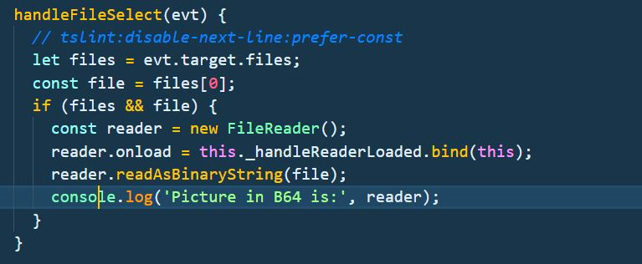
Upload Picture
Next in our component.ts , we have our functions to add a file and to convert it to Base64 and send it via HTTP:

Slide 35
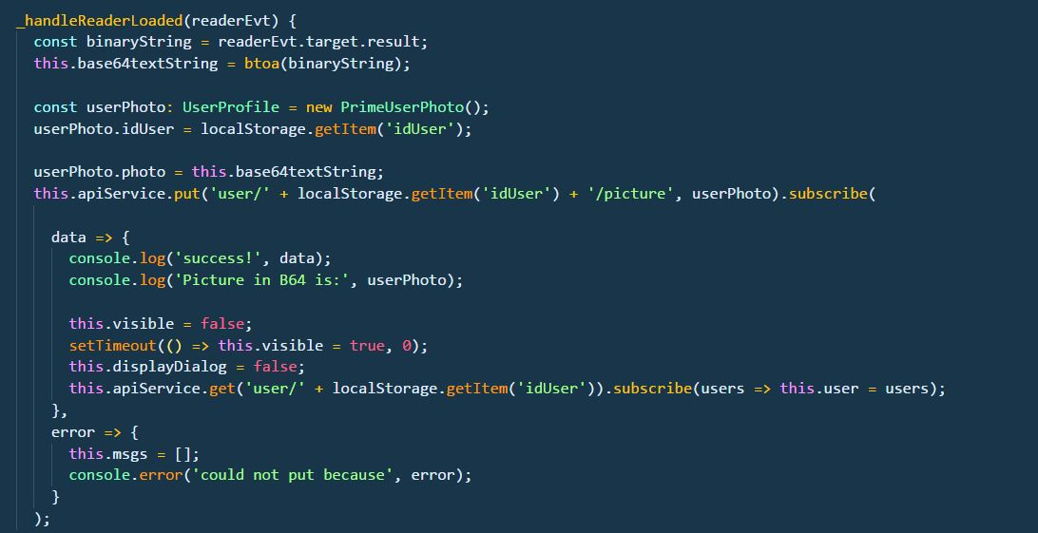
Upload Picture

